Slide 1
Topic 16
Array Applications

Slide 2
Case Study 1
Problem:
Write a program to generate a 5-digit number by randomly generating digits from 0 to 9.
Design the solution:
To randomly generate a digit from 0 to 9, we use the function rand as follows:
Formula:
thevariable = base + rand() % range;
where, range = max – min + 1;
randDigit = rand() % 10;

Slide 3
Case Study 1 – Complete Program
#include <iostream>
#include <cstdlib> // for function rand
#include <ctime>
using namespace std;
int main(void)
{
int randDigit;
// Generate and display random digits
srand(time(NULL));
cout << "The random numbers are: ";
for (int i = 0; i < 5; i++)
{
randDigit = rand() % 10;
cout << randDigit << " ";
}
return 0;
}

Slide 4
Case Study 2
Problem:
We have a set of 70 values between 0 and 19.
We want to know how many of the values are 0, how many are 1, how many are 2, and so on, up to 19.
Develop the solution:
Let’s first consider how to determine how many of the values are 0.
We need a count. The 3 actions for a count:
Initialize the count.
Increment the count by 1 every time we find a 0.
Display the count.

Slide 5
Case Study 2 – Program Development 1
#include <iostream>
#include <cstdlib>
#include <ctime>
#define NUM_VALUES 70
using namespace std;
int main(void)
{
int number, count;
// Initialize the count to 0
count = 0;

Slide 6
Case Study 2 – Program Development 1
// Generate random number and increment
// the count for zeroes
srand(time(NULL));
for (int i = 0; i < NUM_VALUES; i++)
{
number = rand() % 20;
if ( number == 0 )
count++;
}
// Display the count
cout << "Zero appears " << count
<< " times\n";
return 0;
}

Slide 7
Case Study 2
Design the solution:
Now let’s consider how to determine how many of the values are are 0, how many are 1, how many are 2, and so on up to 19.
We need to count for the 20 numbers from 0 to 19.
We need 20 counts – we use an array.
The count is also called frequency, so the array is declared as follows:
int frequency[20];

Slide 8
Case Study 2

Slide 9
Case Study 2
How do we determine which of the array elements to increment? One way is as follows:
if ( number == 0 )
frequency[0]++;
else if ( number == 1 )
frequency[1]++;
else if ( number == 2 )
frequency[2]++;
. . .
else if ( number == 18 )
frequency[18]++;
else
frequency[19]++;

Slide 10
Case Study 2
A better way is as follows:
frequency[number]++;

Slide 11
Case Study 2 – Complete Program
#include <iostream>
#include <iomanip>
#include <cstdlib>
#include <ctime>
#define NUM_VALUES 70
#define SIZE 20
using namespace std;
int main(void)
{
int number, frequency[SIZE] = {0};

Slide 12
Case Study 2 – Complete Program
// Read values and determine frequencies
srand(time(NULL));
for (int i = 0; i < NUM_VALUES; i++)
{
number = rand() % 20;
cout << number << " ";
frequency[number]++;
}
// Display the frequencies
cout << "\nValue Frequency\n";
for (int i = 0; i < SIZE; i++)
cout << setw(2) << i
<< setw(3) << frequency[i] << endl;
return 0;
}

Slide 13
Case Study 3
Problem:
Modify the program to add a function called histogram which displays a histogram based on the frequency array.
The function receives the frequency array as a parameter.
The function is called in main as follows:
histogram( frequency, SIZE );
size of the array

Slide 14
Case Study 3
A sample of the output
is shown here:

Slide 15
Case Study 3 – Complete Function
void histogram(int frequency[], int size)
{
for (int i = 0; i < size; i++)
{
cout << setw(2) << i
<< setw(3) << frequency[i] << " ";
for (int j = 0; j < frequency[i]; j++)
cout << "*";
cout << endl;
}
return;
}

Slide 16
Case Study 4
Problem:
Modify the program in Case Study 1 so that there are no duplicate digits in the randomly generated number.
Design the solution:
We need to make sure the randomly generated digits are not duplicated.
We use an array called haveRand that contains logical values that indicate whether or not the numbers represented by the indexes have been generated before.

Slide 17
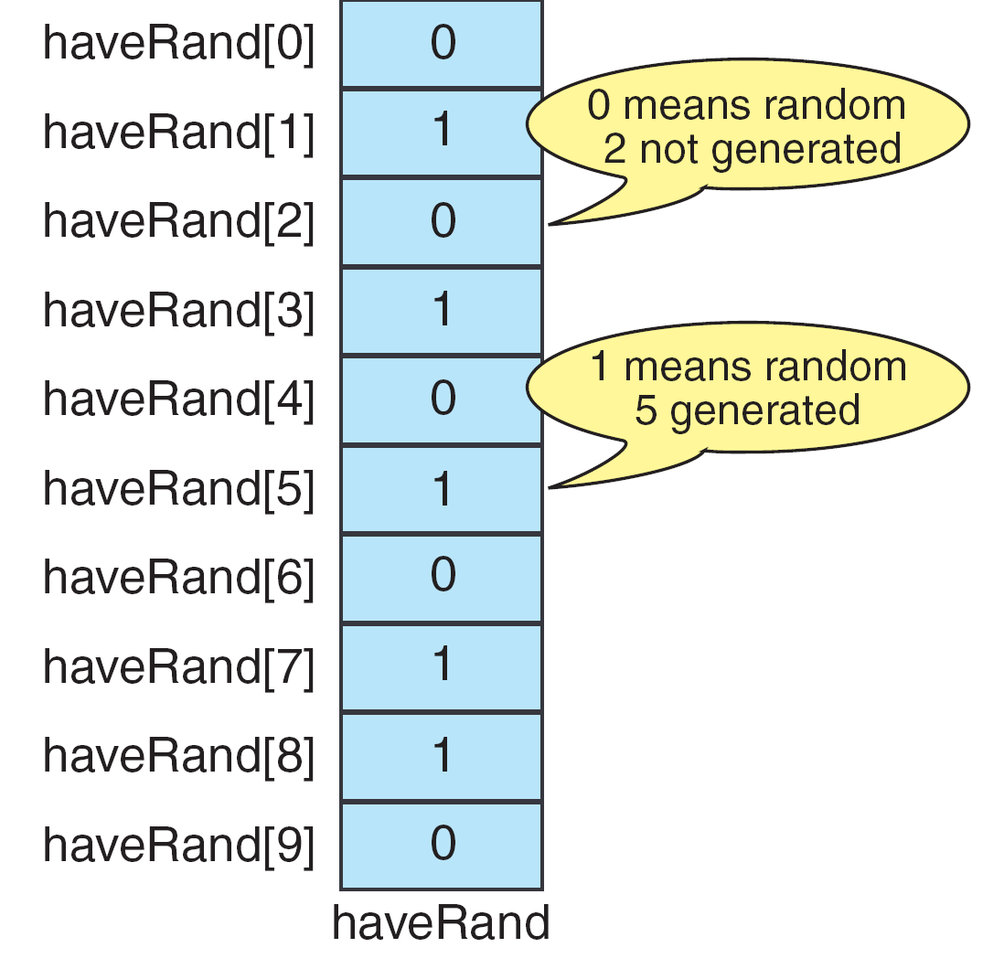
Case Study 4

Slide 18
Case Study 4 – Complete Program
#include <iostream>
#include <cstdlib> // for function rand
#include <ctime>
using namespace std;
int main(void)
{
int randDigit;
bool haveRand[10];
// Initialize array haveRand
for (int i = 0; i < 10; i++)
haveRand[i] = false;

Slide 19
Case Study 4 – Complete Program
srand(time(NULL));
// Generate random digits
for (int i = 0; i < 5; i++)
{
// Ensure no duplicates
do
{
randDigit = rand() % 10;
} while (haveRand[randDigit]);
haveRand[randDigit] = true;
cout << randDigit << " ";
}
return 0;
}

